Slide 1


Ethics in Data Science
Dr. Abolfazl Saghafi
Assistant Professor of Statistics
Data Science Program Director
Notes:
Material for this presentation are adopted from:
A Guide for Ethical Data Science, by Royal Statistical Society (RSS) Data Science Section and the Institute and Faculty of Actuaries (IFoA)

Slide 2
Principles of Data Ethics
There are five relevant ethical themes associated with data science.
1. Seek to enhance the value of data science for society
2. Avoid harm
3. Apply and maintain professional competence
4. Seek to preserve or increase trustworthiness
5. Maintain accountability and oversight
Notes:
As data science methods become more common within statistical and actuarial fields, there are both opportunities and challenges for individuals working in data science.

Slide 3
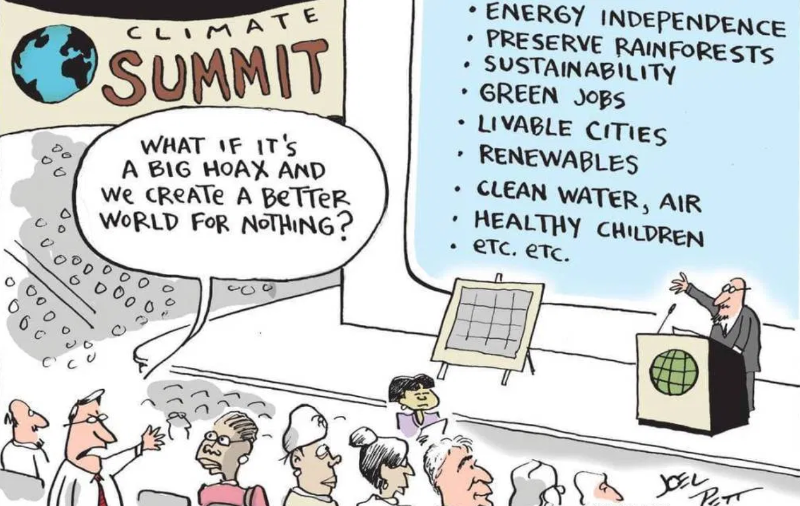
1. Seek to Enhance
Public or societal good has many aspects and could include:
• Economic Empowerment
• Employment • Security and Justice
• Environment • Infrastructure
• Equality and Inclusion • Education
• Health and Hunger
Data science has the potential to be both beneficial and detrimental to individuals and/or the wider public.
To help minimize any adverse effects, members can seek to understand the potential impact of their work and consider any opportunities that may deliver benefits for the public.
https://momentumconsulting.com

Slide 4
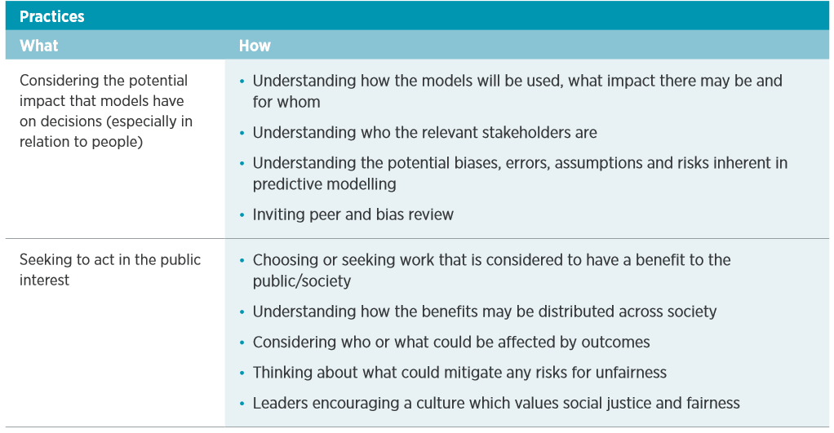
Notes:
Here is a table of examples of how this principle could be put into practice:

Slide 5
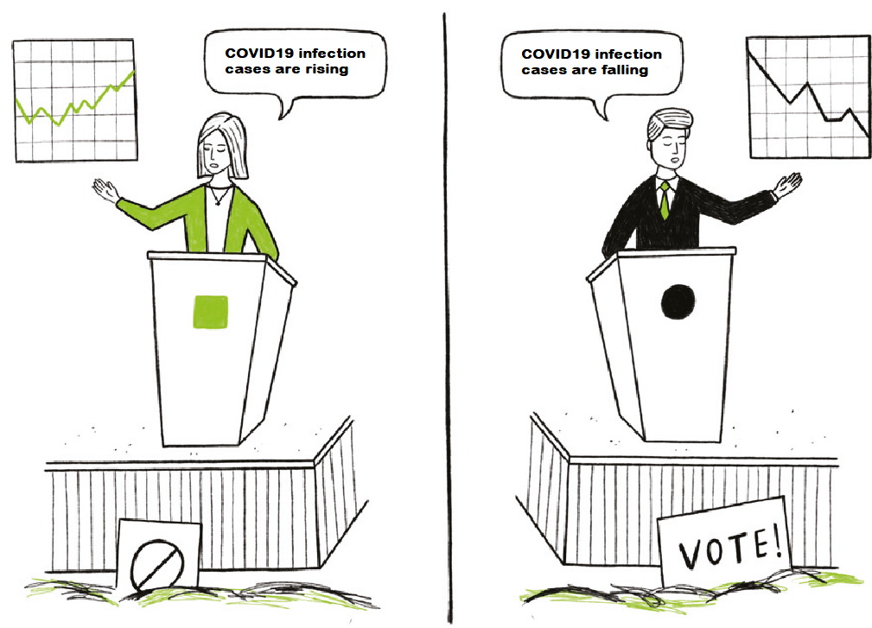
2. Avoid Harm
Examples of potential harm to individuals, public bodies and private organizations could include:
• Financial loss or Disadvantage
• Exclusion from benefits or services
• Damage to reputation, privacy or psychological wellbeing
Data science can involve using potentially sensitive data, such as an individual’s personal information, or have underlying sensitivity due to the volume of data and its ability to link with other sources.
Additionally, newer sources of data, such as social media, have limited capacity for informed consent.
Therefore, as well as applying applicable legal and regulatory obligations, members are encouraged to think broadly about how data could cause harm, both in the context of its current purpose, and any future uses.
https://www.geckoboard.com
Notes:
A good example is when Apple, Amazon, Microsoft stated that they will not share their face recognition technology with the government when Black Lives Matter protest were happening

Slide 6
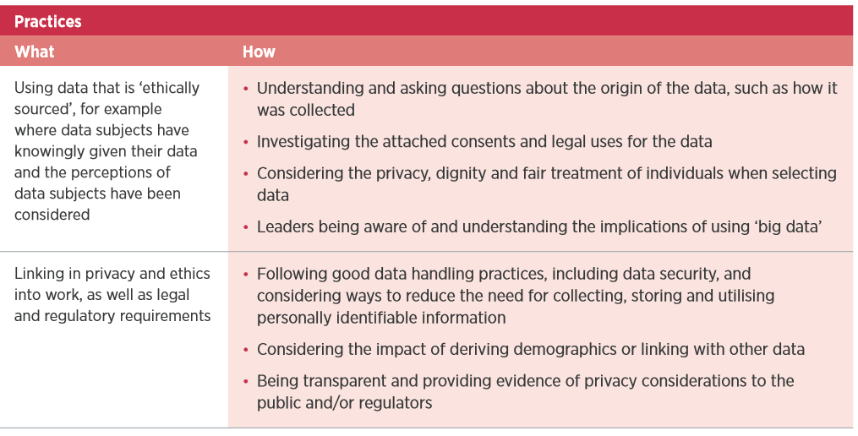
Notes:
These practices contain examples of ways to minimize and manage harm in data science work:

Slide 7
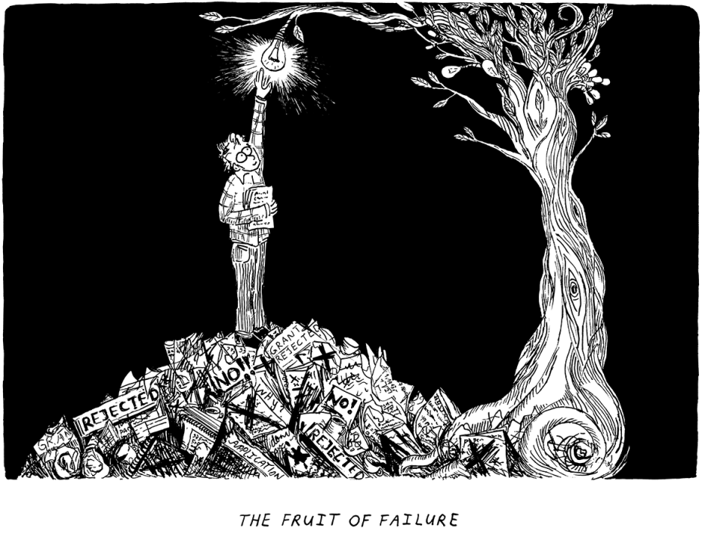
3. Apply & Maintain Professional Competence
Professional competence involves fully understanding the sources of error and bias in data, using ‘clean’ data, and supporting work with robust statistical and algorithmic methods that are appropriate to the question being asked.
Data scientists can help minimize uncertainty and risk in their work by complying with best industry and professional practices and applying analytical rigor.
This links closely with the other listed ethical considerations and can be challenging in the data science setting where the use of data is often complex.
ethz.ch/en/the-eth-zurich/main-focus-areas

Slide 8
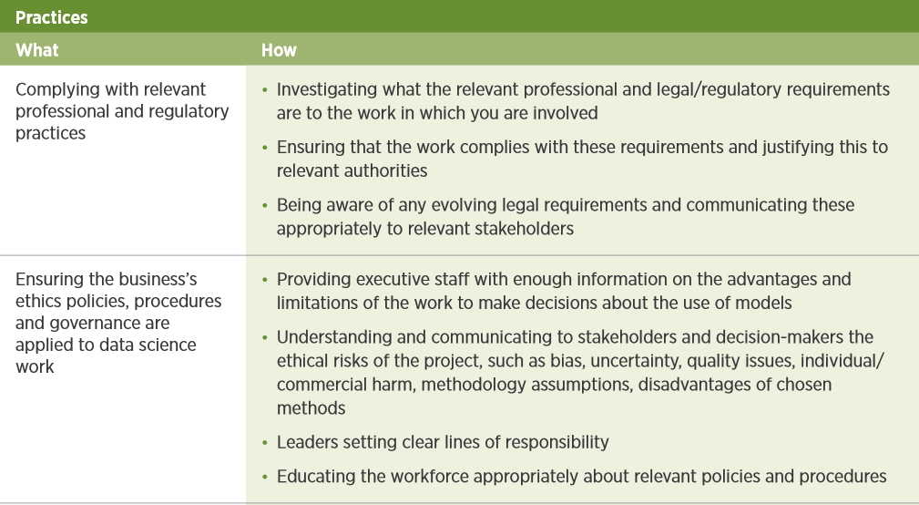
Notes:
These practices may help to maximize the benefits of data science and minimize potential harm.

Slide 9
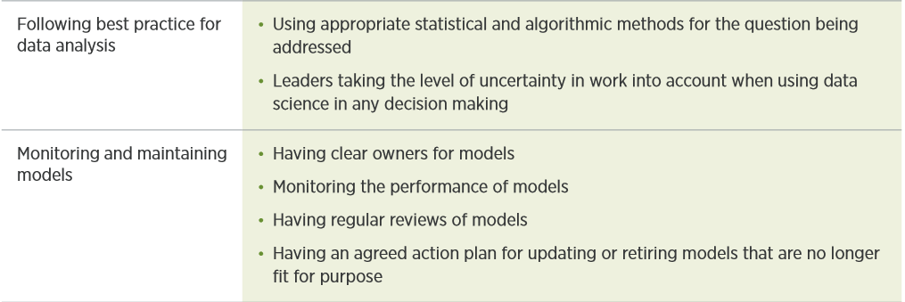
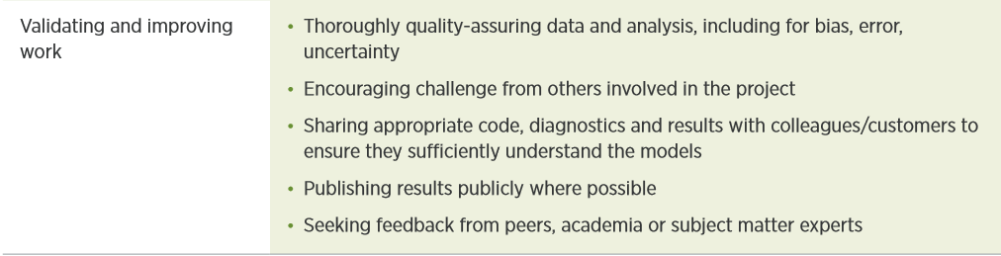
Notes:
These practices may help to maximize the benefits of data science and minimize potential harm.

Slide 10
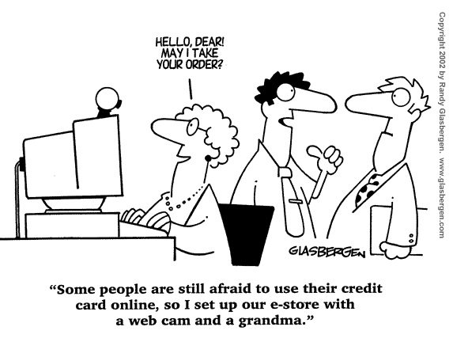
4. Preserve or Increase Trustworthiness
As data science is relatively new area, public perceptions are still evolving and developing. In order to build trust and understanding of their work, data scientists will need to work with the public and stakeholders.
Trustworthiness can be built and maintained if organizations using data science engage regularly with stakeholders, including potential or actual critics, and have an open and honest dialogue about the use of data and AI.
This engagement may also help to better understand potential sources of bias and risk.

Slide 11
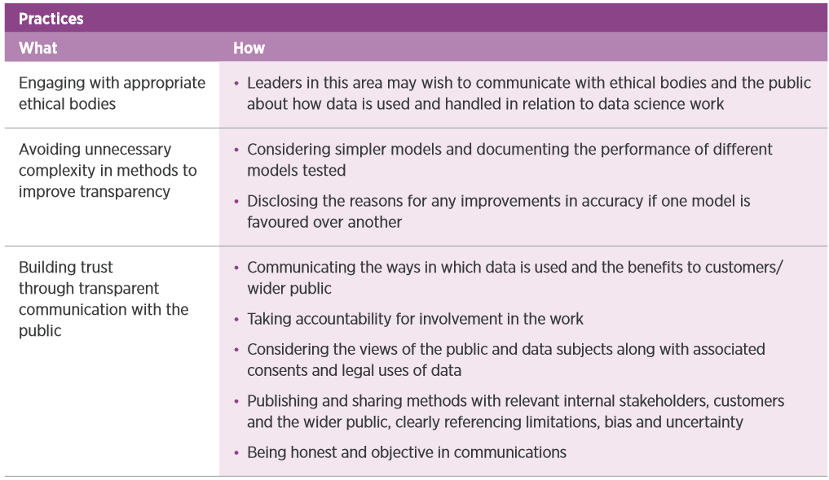
Notes:
This table describes how this could be put into practice.

Slide 12
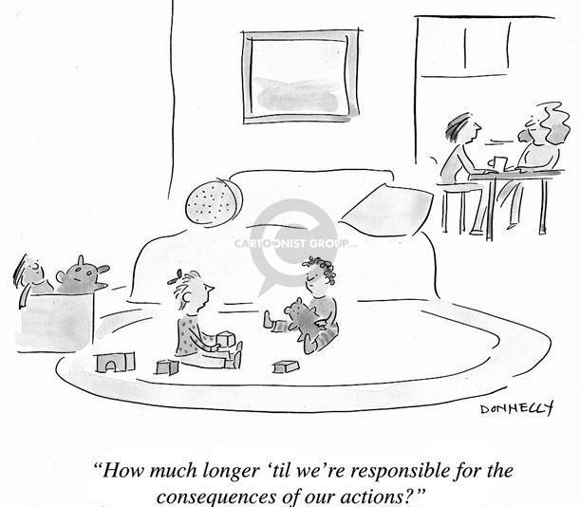
5. Maintain accountability and oversight
Being accountable can include being mindful of how and when to delegate any decision making to systems, and having governance in place to ensure systems deliver the intended objectives.
There are various emerging views on how to manage AI and whether it poses risks to society as well as opportunities.
A common ethical consideration is how accountable individuals are when introducing AI and what level of oversight is put into place when delegating any decision making to machines.

Slide 13
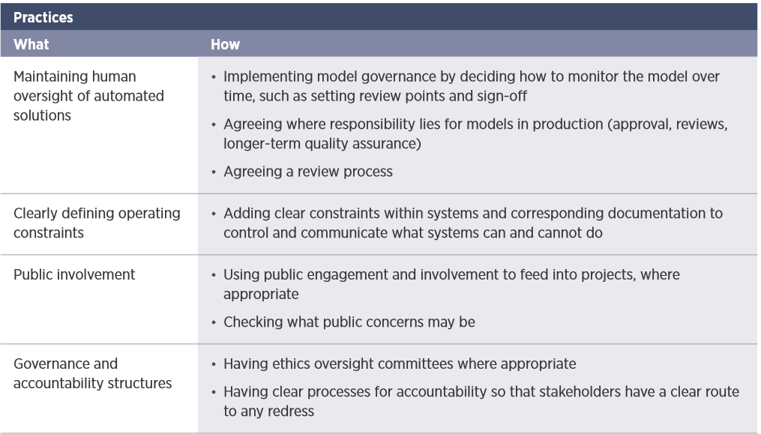
Notes:
This table describes how this could be put into practice.

Slide 14

Notes:
To help embed ethics into your data science work, check out the ethics checklist at the end of the attached document.

